Slide 1
The Role of Knowledge and Internationalisation in Everyday Life
Sanja Stojanović
Novi Sad . Serbia

Slide 3
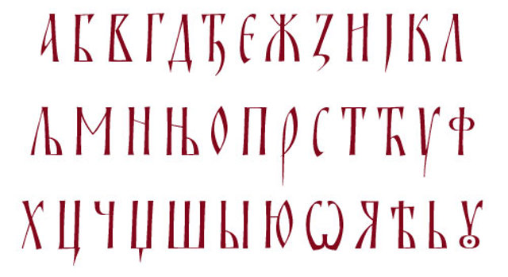

Slide 4
Dubrovnik
Ohrid
Thessaloniki
9th century

Slide 5
Hilandar monastery
Mount Athos

Slide 6
Dubrovnik
Ohrid
Thessaloniki
Hilandar
12th century

Slide 7
Dubrovnik
Ohrid
Thessaloniki
Hilandar
12th century

Slide 8
Dubrovnik
Ohrid
Thessaloniki
Hilandar
12th century

Slide 9
Dubrovnik
Ohrid
Thessaloniki
Hilandar
13th century

Slide 10
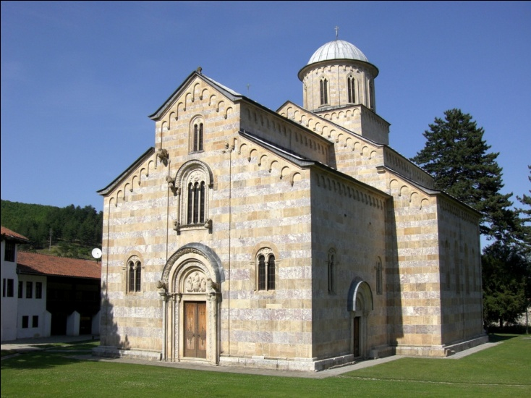
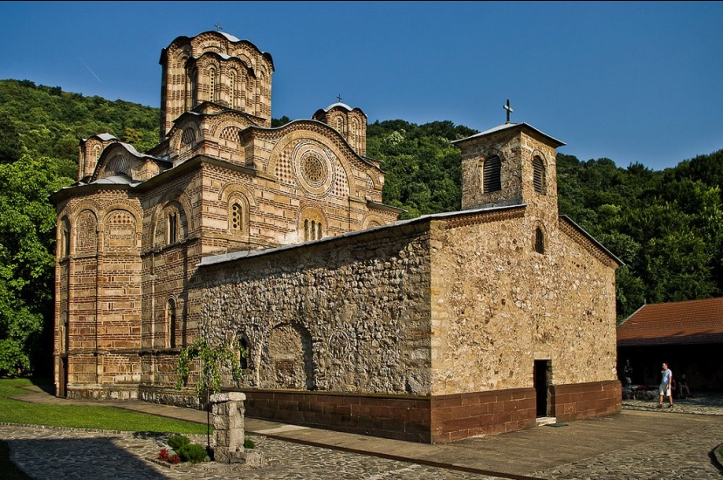
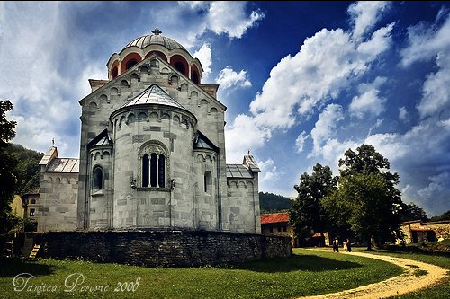
Studenica
Visoki Dečani
Ravanica

Slide 11
Everything was
“very plain and poor”
Chartophyloax John Bekkos
1270s
The whole palace shone
with gold-embroidered silk
Theodore Metochites
1299

Slide 12
Saxon miners
13th century

Slide 13
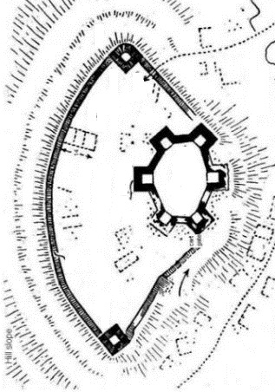

Slide 14
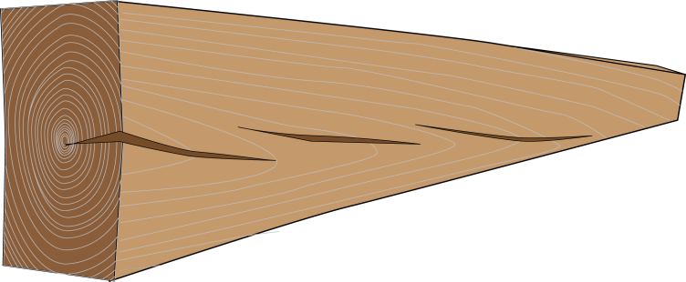
Notes:
Organizacija društva u gradovima, gradsko veće, knez, razni zanati. Pretpostavka novo brdo oko 15000 stanovnika
Stanovanje u kućama, slavlja, društvene igre
Veza izgleda table sa oknma i gradom. Tu navesti priču o životu u gradu, raznim zanimanjima itd. Razvoj gradske kulture i otklon od seoske.

Slide 15
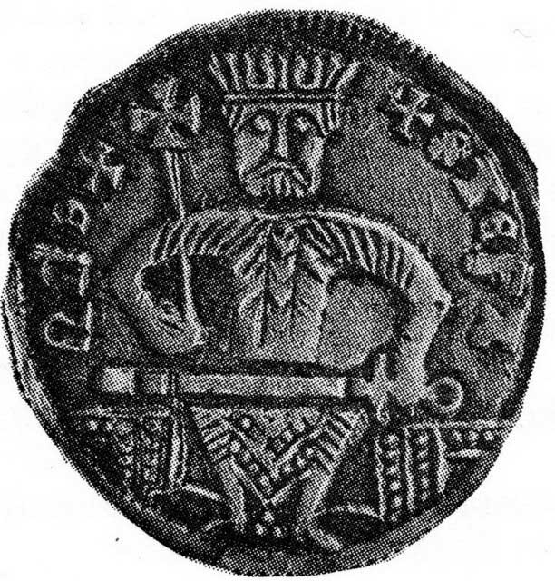
Notes:
Organizacija društva u gradovima, gradsko veće, knez, razni zanati. Pretpostavka novo brdo oko 15000 stanovnika
Stanovanje u kućama, slavlja, društvene igre
Veza izgleda table sa oknma i gradom. Tu navesti priču o životu u gradu, raznim zanimanjima itd. Razvoj gradske kulture i otklon od seoske.

Slide 16
Notes:
Organizacija društva u gradovima, gradsko veće, knez, razni zanati. Pretpostavka novo brdo oko 15000 stanovnika
Stanovanje u kućama, slavlja, društvene igre
Veza izgleda table sa oknma i gradom. Tu navesti priču o životu u gradu, raznim zanimanjima itd. Razvoj gradske kulture i otklon od seoske.

Slide 17
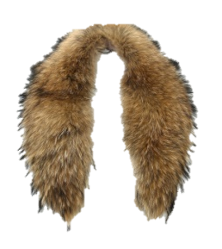
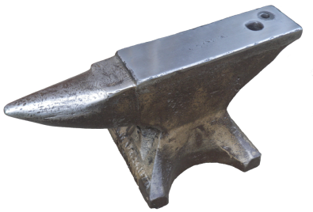
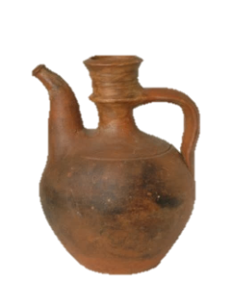
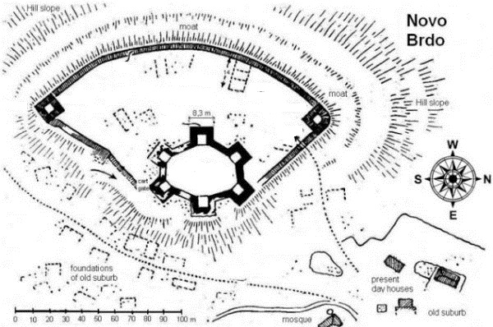
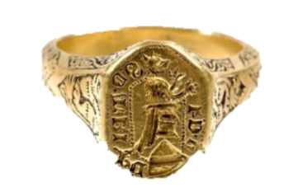
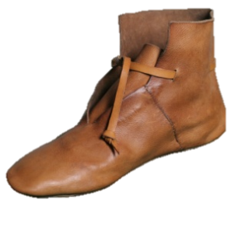
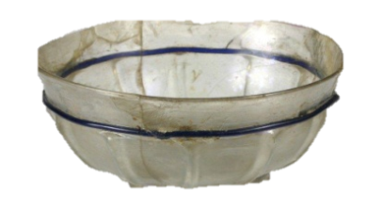
Notes:
Organizacija društva u gradovima, gradsko veće, knez, razni zanati. Pretpostavka novo brdo oko 15000 stanovnika
Stanovanje u kućama, slavlja, društvene igre
Veza izgleda table sa oknma i gradom. Tu navesti priču o životu u gradu, raznim zanimanjima itd. Razvoj gradske kulture i otklon od seoske.

Slide 18
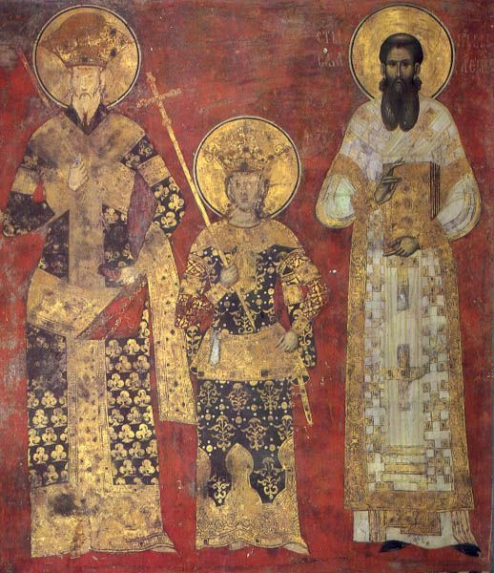
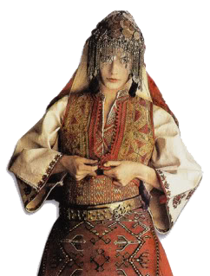

Slide 19
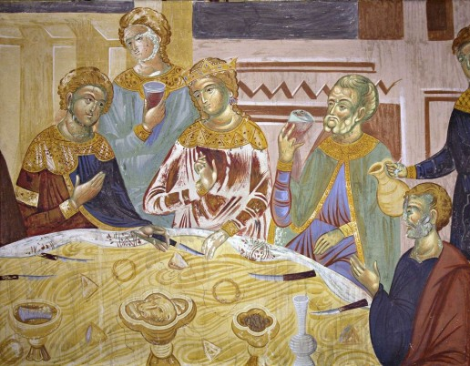

Slide 20
Владислав Граматик
Δημήτριος Καντακουζηνός
Martin Segon
Notes:
Tri učenjaka iz novog brda
Latinica
Ćirilica
alfabet

Slide 21
Borrowed words in Turkish from Serbian
Pekić “ defeated nation continues to exist as an undercurrent of the winner’s tissue “
kutla, čistilac, čistilja, digalj, hodica, kolo
mešajac, nabijač, otučine
plakaonica, pogađaj, polovnik, pravac
pravcar, prečac, preuzboj, proboj, rudnica
rupnik
samokov, sinjac
tarač , ubaština
uzboj
uzbojnik, viganj
vučilac
začeljak, zakon
MINING

Slide 22
Loan words in Turkish from Serbian/Slavic
kožuhar, grnčar, brodar, brveničar, peradar, rešetar, šivac, vlačar, vodeničar, svirac, kokošar, vodar, pekarica, kruhar, ponesar, travar, svećar, kamenar, smrećar, leskovar, krečar, orač, pisar, pudar, pop, glumac...
OTHER TRADES

Slide 23
Нови Сад
Újvidék
Nový Sad
Novi Sad
Neusatz
Neoplanta

Slide 24
FOR NEW
BRIDGES
European Capital of Culture

Slide 25
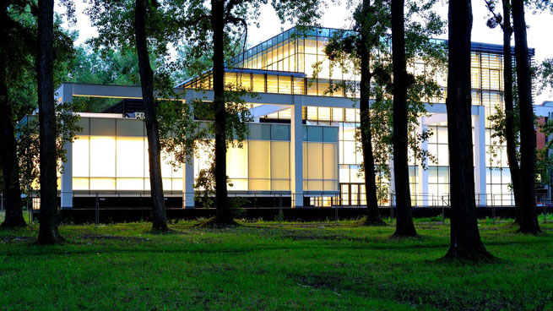
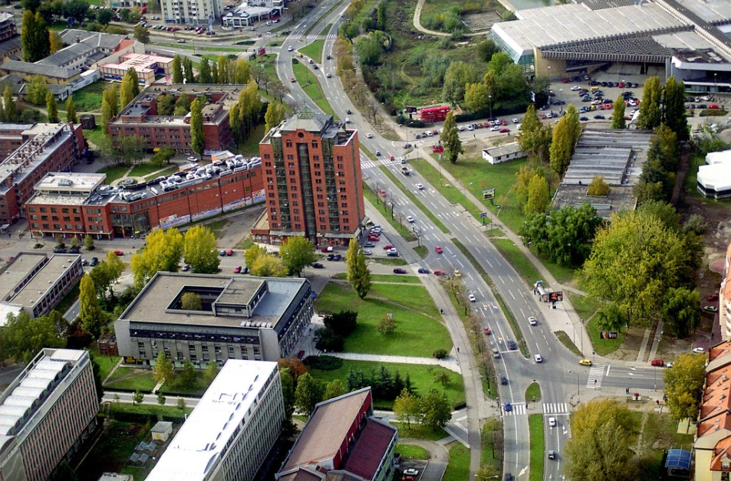
EDUCATION
IN SUBOTICA
TECHNICAL
IN ZRENJANIN
TECHNOLOGY
AGRICULTURE
ARTS
PHILOSOHY
50 000 STUDENts
MATHEMATICS
LAW
MEDICINE
SPORT
CIVIL ENGINEERING
TECHNICAL SCIENCES
ECONOMY
IN SUBOTICA
EDUCATION
IN SOMBOR

Slide 27
Internationalisation
Education
Science
International mobility
Cooperation
Technology
and
inovation

Slide 28
Erasmus+ KA1
Over 110 partner institutions;
Increased mobility in 2016/17.
Erasmus+ KA2

Slide 29
Continual activity
Constant coordination with TEMPUS Foundation
Local coordination of incoming mobilies

Slide 30
2016.
3 module cicles
7 modules in different fields of study
14 lecturers
191 attendants
2017.
International conference on Education
of academic personnel of West Balkans

Slide 31
Mobility 2016/17.
ERASMUS+ Incoming mobility: 294 (120 students; 174 staff) Outcoming mobility: 434 (258 student;176 staff) CEEPUS Incoming mobility: 64 staff, 35 students
Outcoming mobility: none ERASMUS MUNDUS ACTION 2 - EUROWEB+ - 2 Incoming mobility: 2 students Outcoming mobility: none
SUNBEAM - 22 Incoming mobility: 6 Outcoming mobility: 16 IN GENERAL - INCOMING AND OUTCOMING 851

Slide 32
Bilateral agreements
ALBANIA Agricultural University, Tirana AUSTRIA Alpen-Adria University, Klagenfurt BOKU University of Natural Resources and Life Sciences, Vienna Graz University of Technology, Graz Karl-Franzens University of Graz, Graz Leopold-Franzens University of Innsbruck, Innsbruck AZERBAIJAN Baku State University BELGIUM Ghent University BELARUS Francisk Skorina Gomel State University, Gomel BOSNIA AND HERZEGOVINA University of Banja Luka University of Bihać Dzemal Bijedic University of Mostar, Mostar University of East Sarajevo University of Sarajevo University of Tuzla BULGARIA Technical University of Sofia Konstantin Preslavsky University of Shumen, Shumen GREAT BRITAIN University of Sheffield EGYPT Ministry of Agriculture and Land Reclamation, Cairo FRANCE University of Versailles Saint-Quentin-en-Yvelines, Yvelines Ecole normale supérieure de Cachan, Cachan University Paris 13 University of Strasbourg, Strasbourg Charles de Gaulle University – Lille III, Lille GREECE Centre for the Yugoslav Studies North College, Thessaloniki Aristotle University of Thessaloniki, Thessaloniki CROATIA Juraj Dobrila University of Pula University of Rijeka University of Split University of Zagreb INDIA Pune University – Arts, Science and Commerce College, Pune INDONESIA Gunadarma University, Jakarta
ITALY Marche Polytechnic University, Ancona University of Bari Aldo Moro, Bari University of Catania University of Florence University of Parma University of Trieste University of Udine University of Basilicata, Potenza Polytechnic University of Bari
SOUTH AFRICA University of the Witwatersrand, Johannesburg University of Mpumalanga, Mbombela
ROMANIA Banat University of Agricultural Sciences and Veterinary Medicine, Timișoara Politehnica University of Timișoara Technical University of Cluj-Napoca Transilvania University of Brasov University of Bucharest University of Craiova University of Pitesti “Vasile Goldis” Western University of Arad, Arad RUSSIAN FEDERATION Volga Region Academy of Physical Culture, Sport and Tourism St. Petersburg State University of Ecomomics Petersburg State Transport University, St. Petersburg Ukhta State Technical University Lobachevsky State University of Nizhny Novgorod St. Petersburg State University of Technology and Design Kemerovo State University Omsk State University Northern Arctic Federal University Nizhny Novgorod Institute of Agriculture Moscow Institute of Fire Safety I.M. Sechenov Moscow Medical Academy National University of Science and Technology ‘MISiS’, Moscow UNITED STATES OF AMERICA Cleveland State University Indiana University – Purdue University Fort Wayne SLOVAKIA Academy of Arts in Banská Bystrica University of Economics in Bratislava Comenius University in Bratislava Technical University of Košice University of Presov University of Ss. Cyril and Methodius in Trnava Alexander Dubček University of Trenčin Matej Bel University, Banská Bystrica SLOVENIA University of Ljubljana University of Maribor University of Primorska, Koper SPAIN University of Valladolid SERBIA ‘ID net’ State University of Novi Pazar University of Arts in Belgrade SWITZERLAND International Academy for Human Sciences and Culture, Walenstadt THAILAND Prince of Songkla University, Hat Yai TAIWAN National Chung Cheng University TURKEY Yildiz Technical University, Istanbul ’19 May’ University, Samsun İstanbul Gelişim University Ondokuz Mayis University, Samsun UKRAINE Kherson State University Odessa National Academy of Food Technologies Yuriy Fedkovych Chernivtsi National University
CANADA University of Prince Edward Island CHINA Donghua University, Shanghai Zhejiang Agriculture & Forestry University, Hangzhou Zhongnan University of Economics and Law, Wuhan China Agricultural University, Beijing Northeast Forestry University, Harbin Ningbo University, Ningbo Changshu Institute of Technology, Changshu CHINA AND THAILAND Prince of Songkla University and Shanghai University LIBYA Academy of Diplomatic Studies HUNGARY Deloitte Auditing and Consulting Limited Eötvös Loránd University, Budapest University of Pannonia, Veszprém University of Pécs University of Szeged University of West Hungary, Sopron MACEDONIA State University of Tetova Saints Cyril and Methodius University, Skopje MEXICO National Autonomous University of Mexico, Mexico City GERMANY European University Viadrina, Frankfurt (Oder) German Aerospace Center - DLR Albert Ludwig University of Freiburg, Freiburg Trier University of Applied Sciences, Trier Ulm University of Applied Sciences, Ulm University of Regensburg University of Rostock POLAND Jagiellonian University, Cracow Cracow University of Technology, Cracow Adam Mickiewicz University, Poznan Wroclaw University of Environmental and Life Sciences, Wroclaw AGH University of Science and Technology University of Gdansk University of Lodz University of Rzeszow PORTUGAL University of Coimbra University of Porto CZECH REPUBLIC University of Hradec Králové Global Change Research Institute, Brno Masaryk University, Brno Slovak University of Technology, Bratislava

Slide 33
Kraków

Slide 34
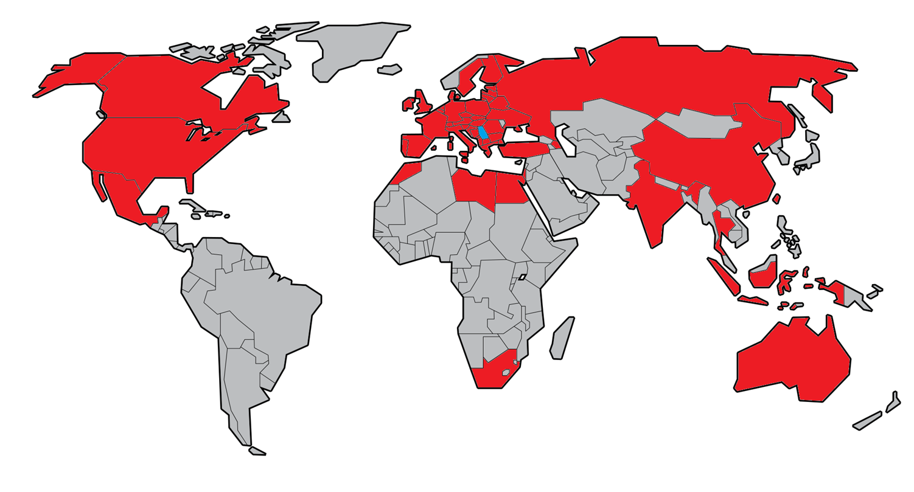

Slide 35
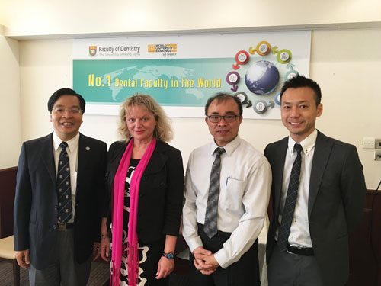
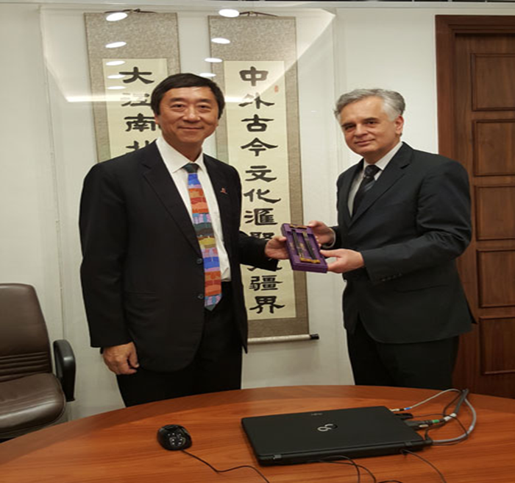

Slide 36
Current issues
Recognition of studies in Europe
University incomes
State funds
Own income
Private Universities
Online studies
Advantages
Dangers

Slide 37
Current issues
Government regulates education
Interference with autonomy of university
Coordination of Scientific Institutes with
the field of production

Slide 38
Recognition of studies in Europe
ERASMUS+
Non EU countries

Slide 39
University incomes
State funds
Own income
Startup companies

Slide 40
Coordination of Scientific Institutes with field of production

Slide 41
The best non-management salaries in Serbia

Slide 42
Influence of companies on University
Influence on programmes of studies
Migration of University personnel into
the Industry

Slide 43
Private Universities
Quality control

Slide 44
Online studies
Advantages
Disadvanteges

Slide 45
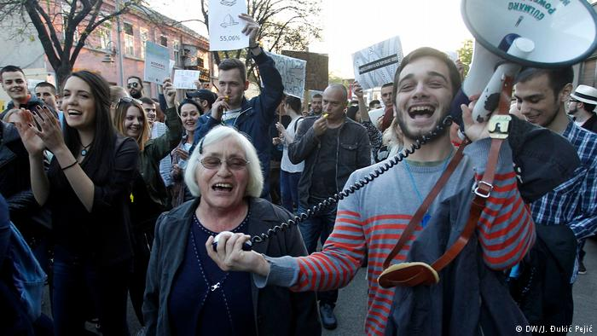
Government regulates education
Interference
with
the autonomy
of
university

Slide 47
Mais une idée, cela ne pousse pas comme cela dans la tête des gens ;
il en faut, des ingrédients et des engrais, pour l’amener jusqu’à la naissance !

Slide 48
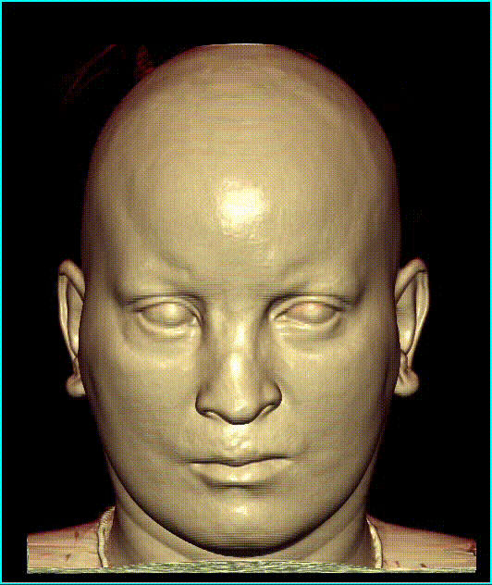
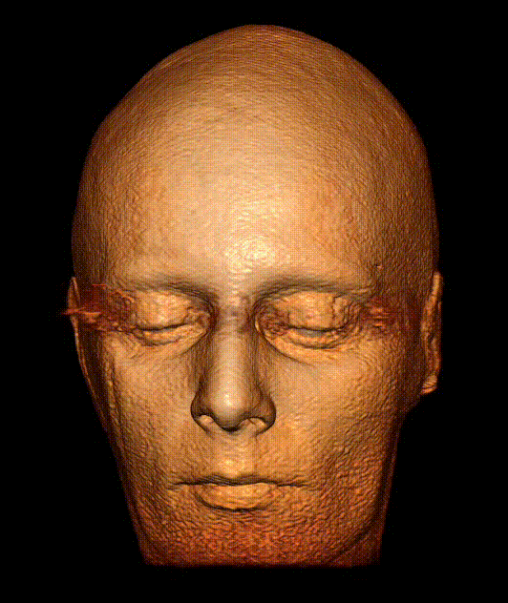

Slide 49
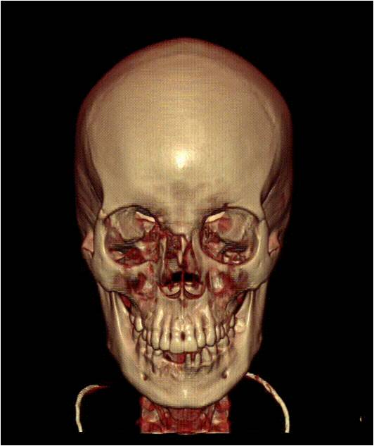
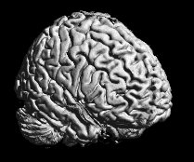

Slide 50
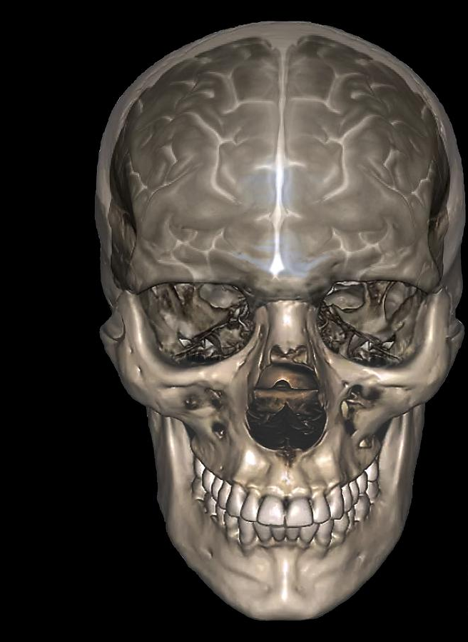

Slide 52
THANK YOU
FOR YOUR ATTENTION

